Slide 1
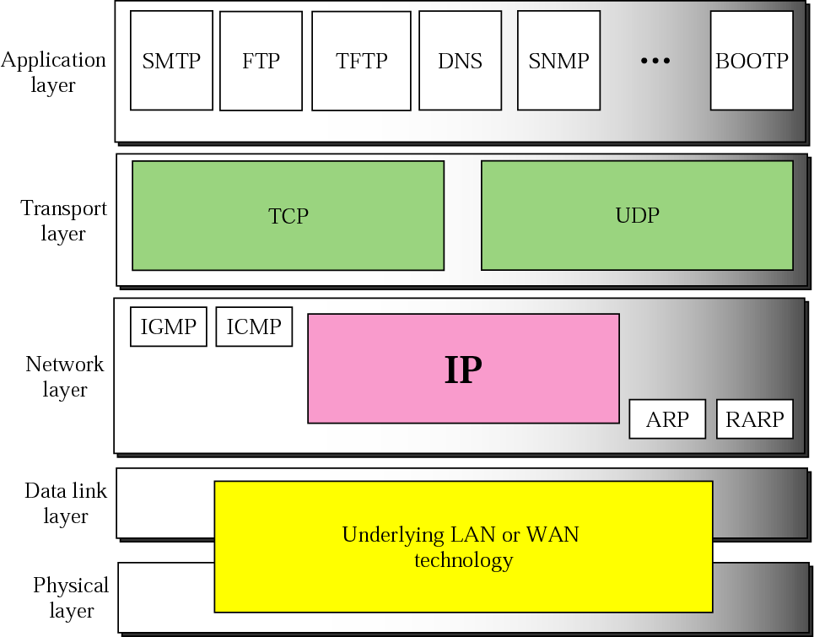
Position of IP in TCP/IP protocol suite

Slide 2
IP is an unreliable and connectionless protocol
A packet in the IP layer is called a datagram
IP provides best-effort delivery service – means no error checking or tracking.
If reliability is important, IP must be paired with reliable protocol such as TCP.
A datagram is variable-length packet consisting of two parts: header and data
The header is 20 to 60 bytes in length and contains information essential to routing and delivery.

Slide 3
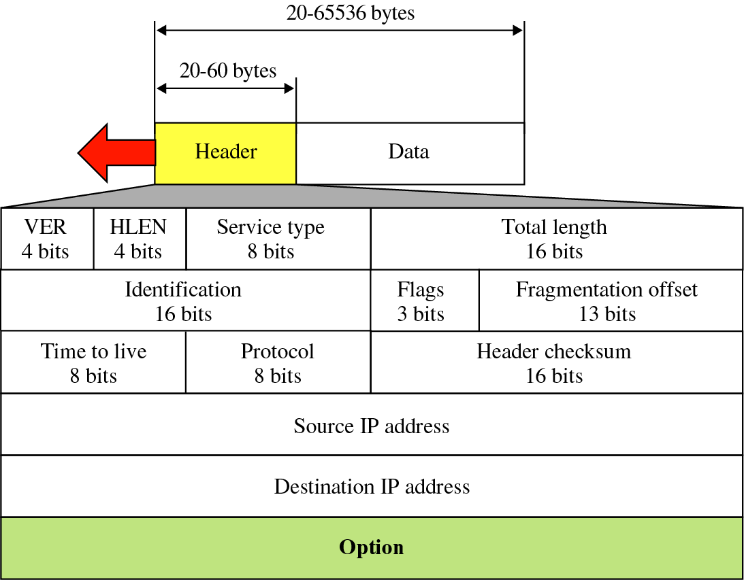
IP datagram

Slide 4
Version (VER)
4-bits, defines version of IP protocol
Header length (HLEN)
4-bits, defines length of datagram header in 4-byte words
Min size :20(5x4), max size:60(15x4)
Differentiated service (DS)
8-bits
First 6 make up the Codepoint. Last2 are not used
Codepoint can be used in two different ways –
When 3 right-most bits are 0s, 3 left-most bits are interpreted as precedence bits

Slide 5
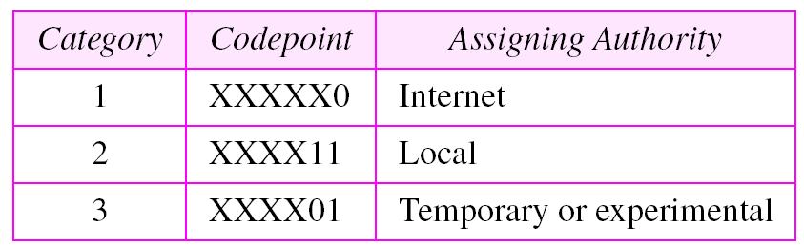
2. When 3 right-most bits are not all 0s, 6 bits define 64 services based on priority assignment by Internet or local authorities
Codepoints values for 64 services

Slide 6
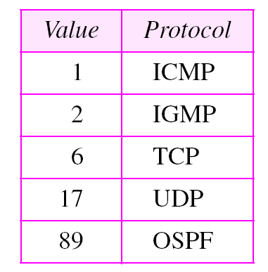
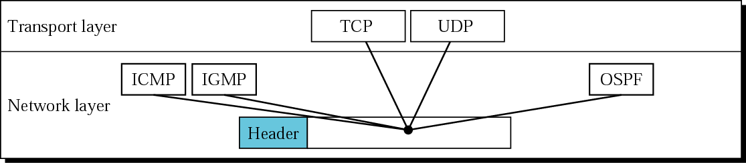
Total length
16-bits, defines total length (header+data) of IP datagram
Time to live
8-bits, defines lifetime of datagram over Internet
Protocol
8-bits, defines higher level protocol that uses service of IP layer
Values of Protocol field

Slide 7
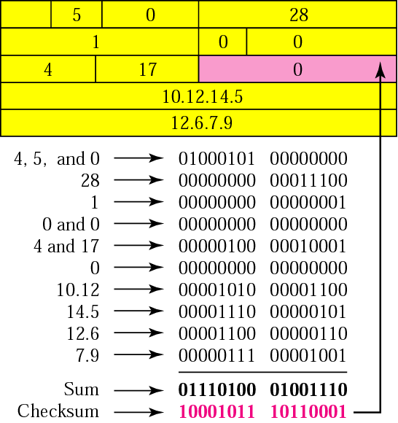
Header checksum
16-bits, used against corruption during transmission
Example of checksum calculation in binary

Slide 8
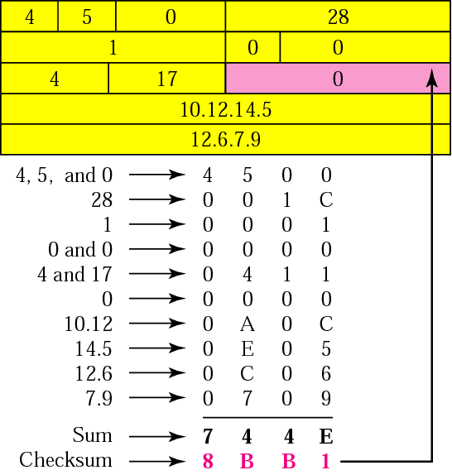
Example of checksum calculation in hexadecimal

Slide 9
Source address
32-bits, defines IP address of source
Destination address
32-bits, defines IP address of destination

Slide 10
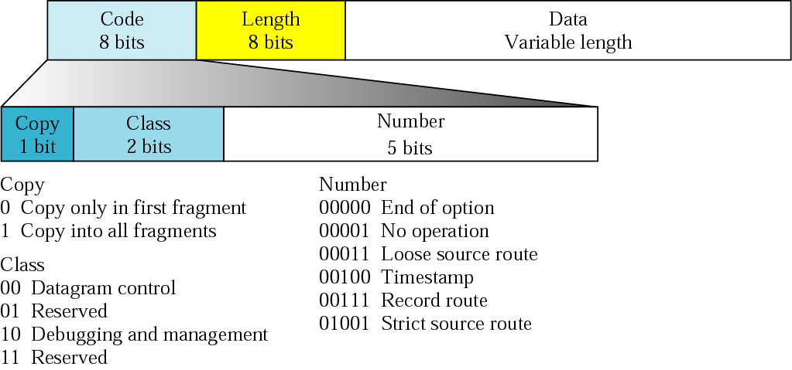
Option format

Slide 11
An IP packet has arrived with the first 8 bits as shown:
⬅ 01000010
The receiver discards the packet. Why?

Slide 12
There is an error in this packet. The 4 left-most bits (0100) show the version, which is correct. The next 4 bits (0010) show the header length, which means (2 × 4 = 8), which is wrong. The minimum number of bytes in the header must be 20. The packet has been corrupted in transmission.

Slide 13
In an IP packet, the value of HLEN is 1000 in binary. How many bytes of options are being carried by this packet?

Slide 14
The HLEN value is 8, which means the total number of bytes in the header is 8 × 4 or 32 bytes. The first 20 bytes are the main header, the next 12 bytes are the options.

Slide 15
An IP packet has arrived with the first few hexadecimal digits as shown below:
⬅ 45000028000100000102...................
How many hops can this packet travel before being dropped? The data belong to what upper layer protocol?

Slide 16
To find the time-to-live field, we should skip 8 bytes (16 hexadecimal digits). The time-to-live field is the ninth byte, which is 01. This means the packet can travel only one hop. The protocol field is the next byte (02), which means that the upper layer protocol is IGMP.

Slide 17
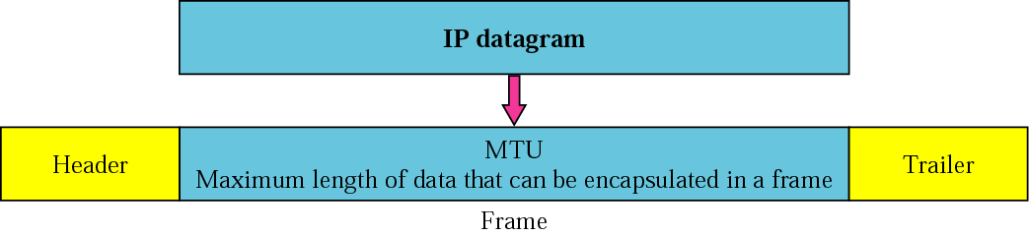
Fragmentation
The format and size of a frame depend on the protocol used by the physical network. A datagram may have to be fragmented to fit the protocol regulations.
MTU

Slide 18
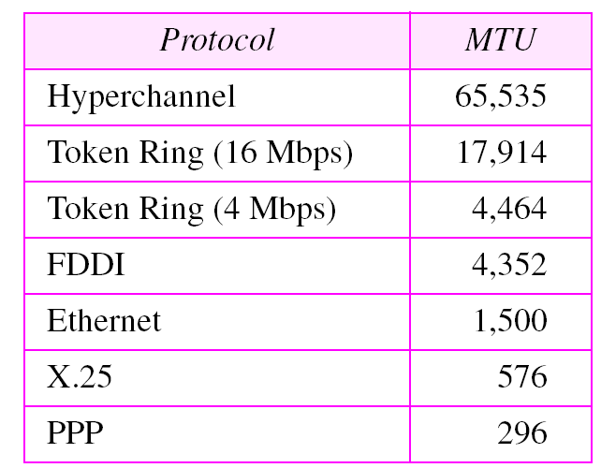
MTUs for some networks

Slide 19
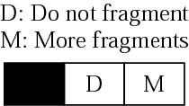
Fields related to Fragmentation
Identification
16-bits
uniquely identifies the fragments of a datagram
Flags
Fragmentation offset
13 bits
Values of offset is measured in units of 8 bytes

Slide 20
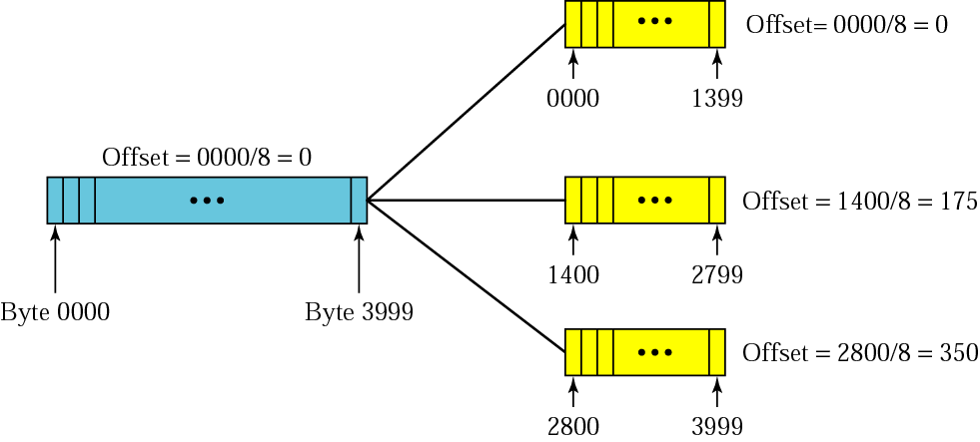
Fragmentation example

Slide 21
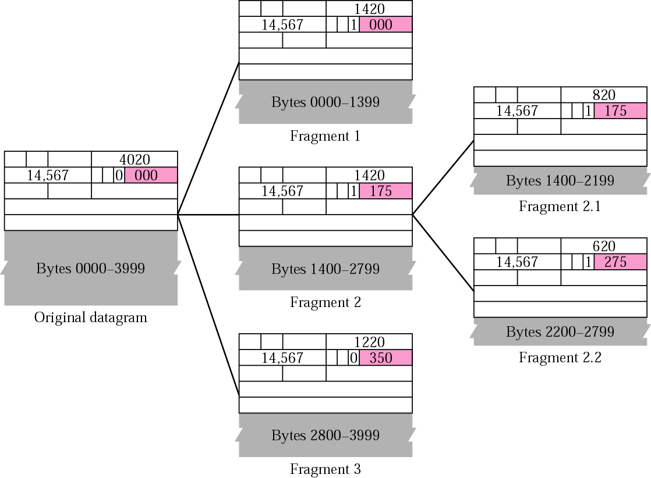

Slide 22
A packet has arrived with an M bit value of 0. Is this the first fragment, the last fragment, or a middle fragment? Do we know if the packet was fragmented?
Solution If the M bit is 0, it means that there are no more fragments; the fragment is the last one. However, we cannot say if the original packet was fragmented or not. A nonfragmented packet is considered the last fragment.

Slide 23
A packet has arrived with an M bit value of 1. Is this the first fragment, the last fragment, or a middle fragment? Do we know if the packet was fragmented?
Solution If the M bit is 1, it means that there is at least one more fragment. This fragment can be the first one or a middle one, but not the last one. We don’t know if it is the first one or a middle one; we need more information (the value of the fragmentation offset).

Slide 24
A packet has arrived with an M bit value of 1 and a fragmentation offset value of zero. Is this the first fragment, the last fragment, or a middle fragment?.
Solution Because the M bit is 1, it is either the first fragment or a middle one. Because the offset value is 0, it is the first fragment.

Slide 25
A packet has arrived in which the offset value is 100. What is the number of the first byte? Do we know the number of the last byte?
Solution To find the number of the first byte, we multiply the offset value by 8. This means that the first byte number is 800. We cannot determine the number of the last byte unless we know the length of the data.

Slide 26
A packet has arrived in which the offset value is 100, the value of HLEN is 5 and the value of the total length field is 100. What is the number of the first byte and the last byte?
Solution The first byte number is 100 × 8 = 800. The total length is 100 bytes and the header length is 20 bytes (5 × 4), which means that there are 80 bytes in this datagram. If the first byte number is 800, the last byte number must be 879.

Slide 27
Option format
Length: defines total length, not present in all option types.
Data: contains data that specific options require, like length field this field also not present in all option types.

Slide 28
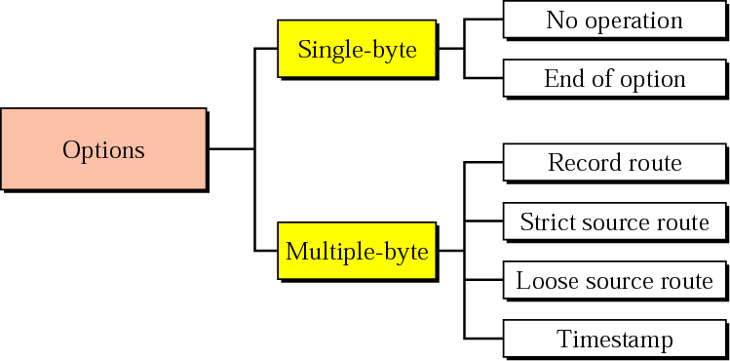
Categories of options

Slide 29
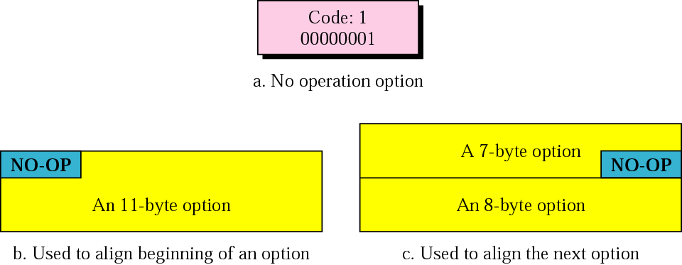
No operation option

Slide 30
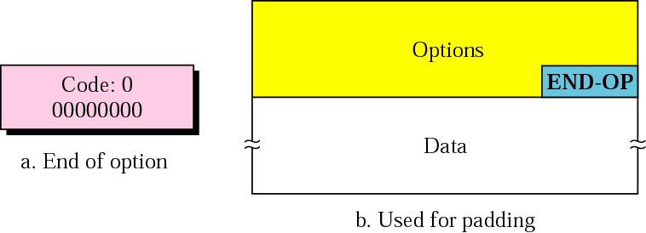
End of option

Slide 31
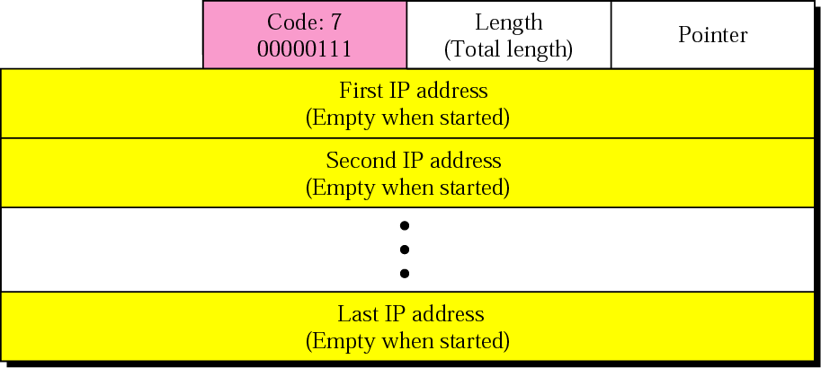
Record route option

Slide 32
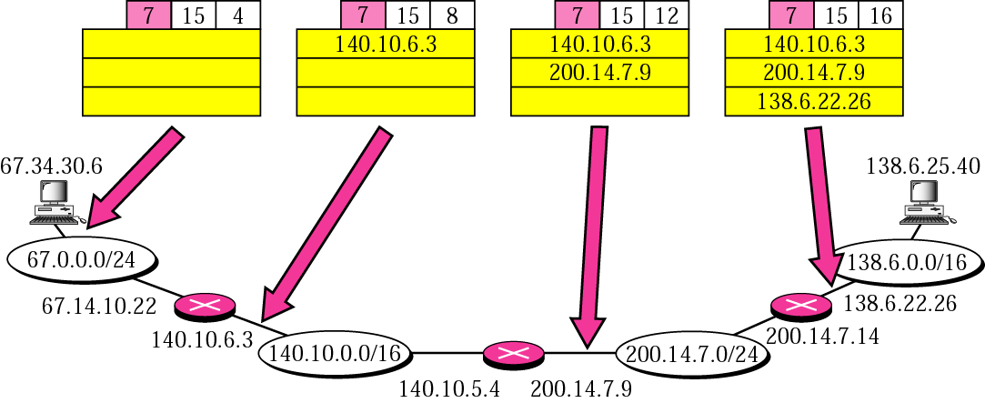

Slide 33
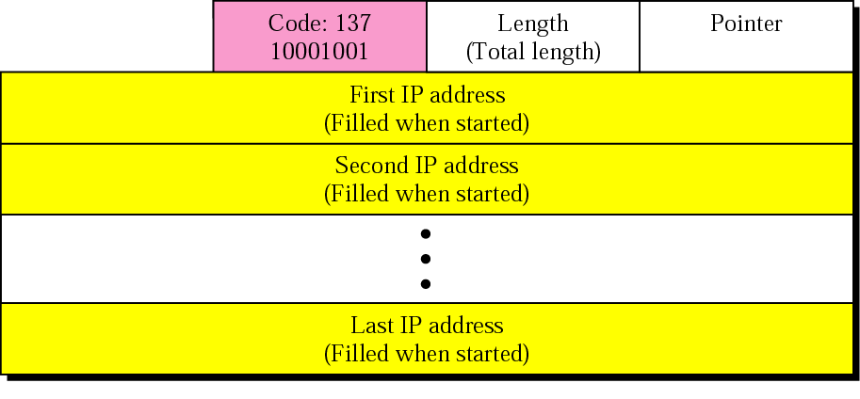
Strict source route option

Slide 34
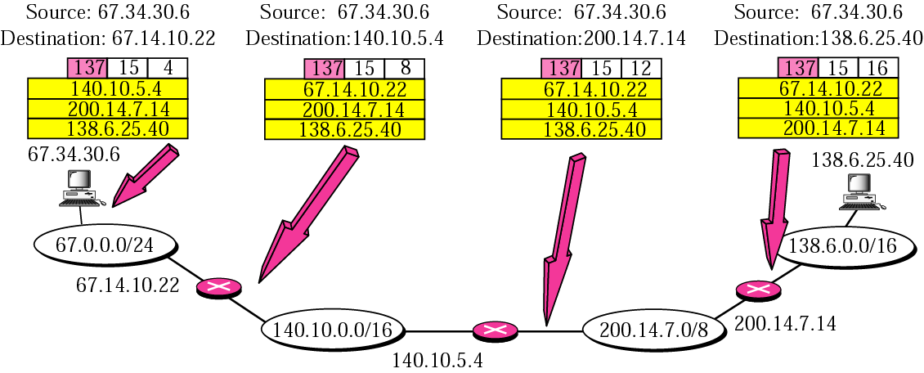

Slide 35
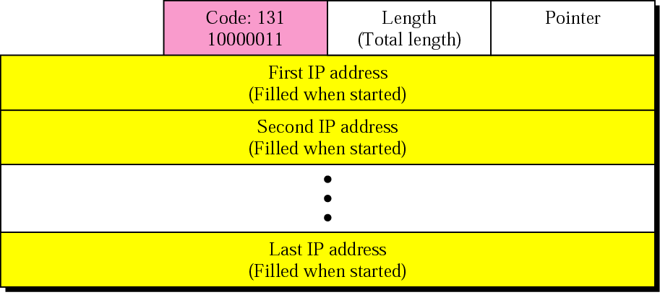
Loose source route option

Slide 36
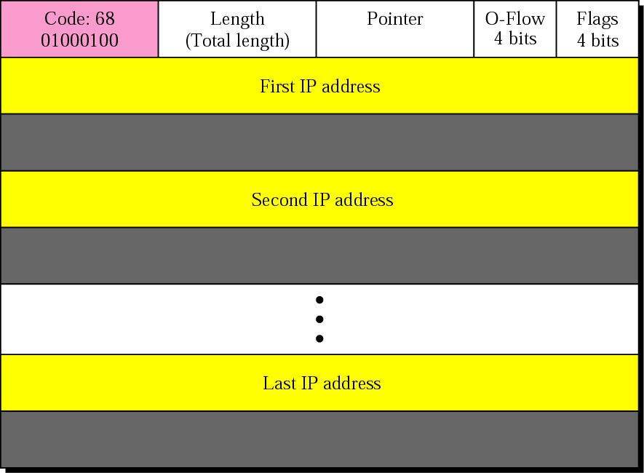
Timestamp option

Slide 37
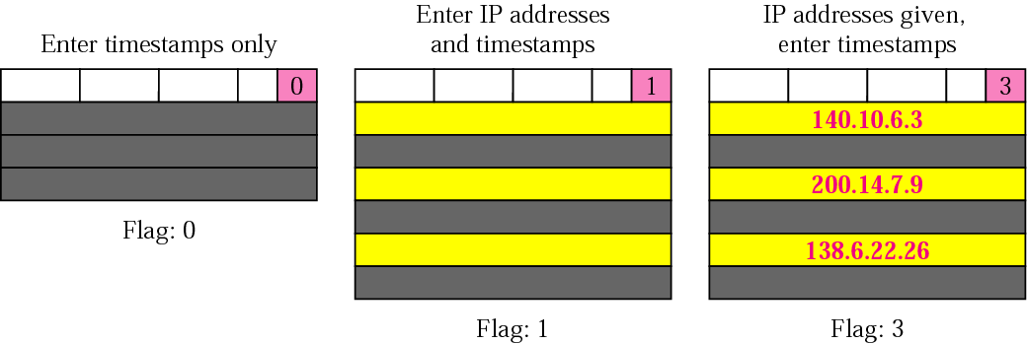
Use of flag in timestamp

Slide 38
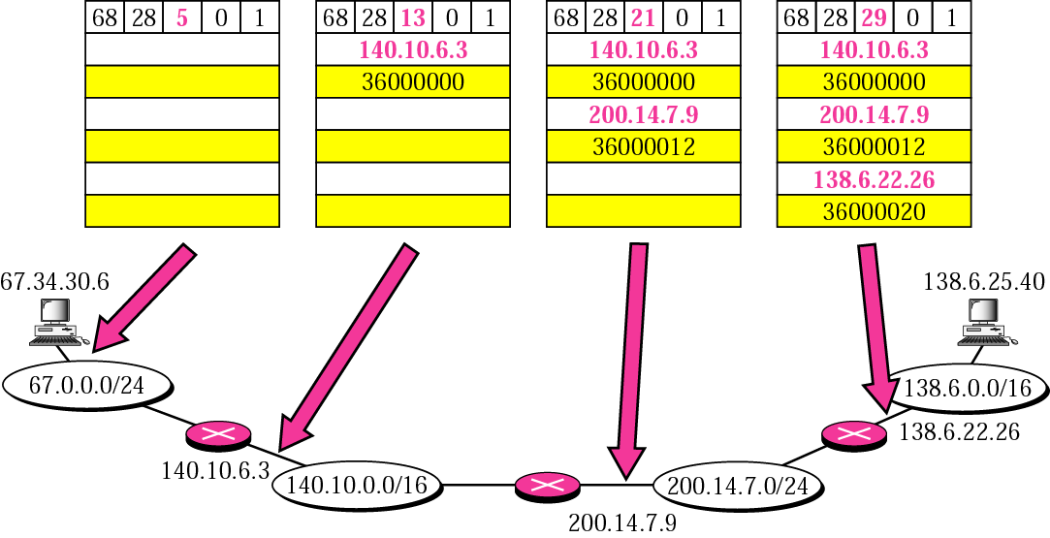

Slide 39
Internet Control
Message Protocol
(ICMP)

Slide 40
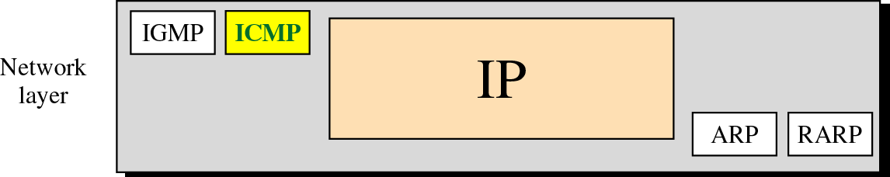
Position of ICMP in the network layer

Slide 41
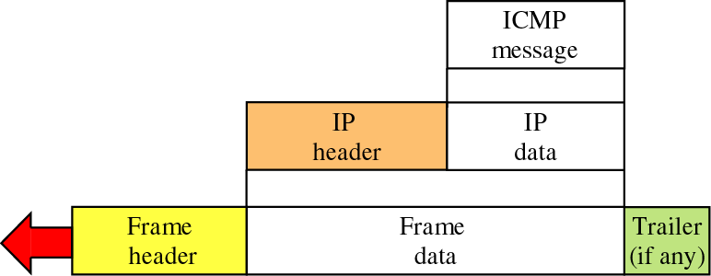
Encapsulation of ICMP packet

Slide 42
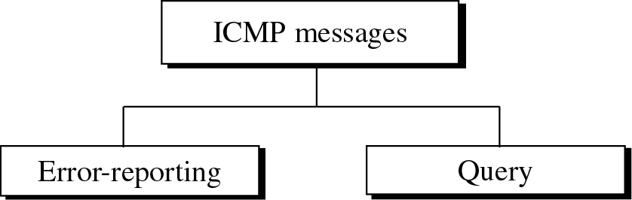
ICMP messages

Slide 43
ICMP messages
Category | Type | Message
Error-reporting messages | 3 | Destination unreachable
 | 4 | Source quench
 | 11 | Time exceeded
 | 12 | Parameter problem
 | 5 | Redirection
Query messages | 8 or 0 | Echo request or reply
 | 13 or 14 | Timestamp request or reply
 | 17 or 18 | Address mask request or reply
 | 10 or 9 | Router solicitation or advertisement

Slide 44
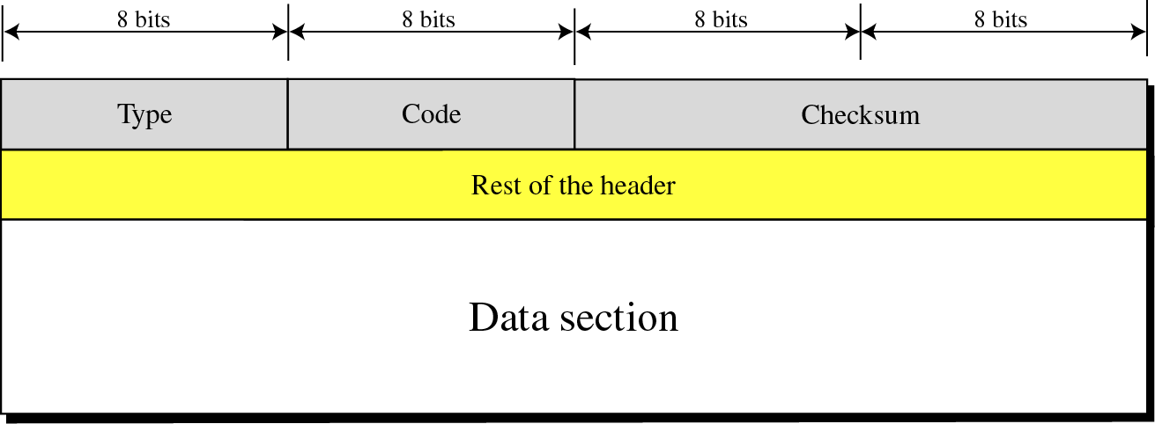
General format of ICMP messages

Slide 45
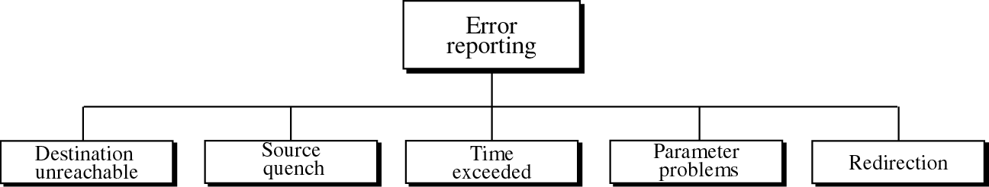
Error-reporting messages

Slide 46
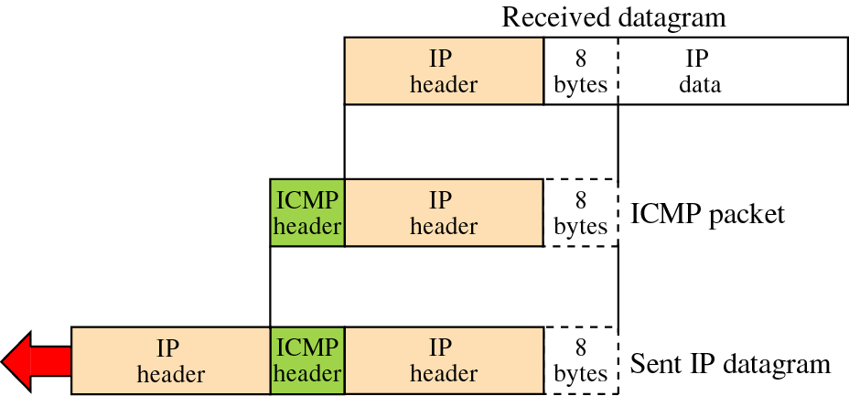
Contents of data field for error messages

Slide 47
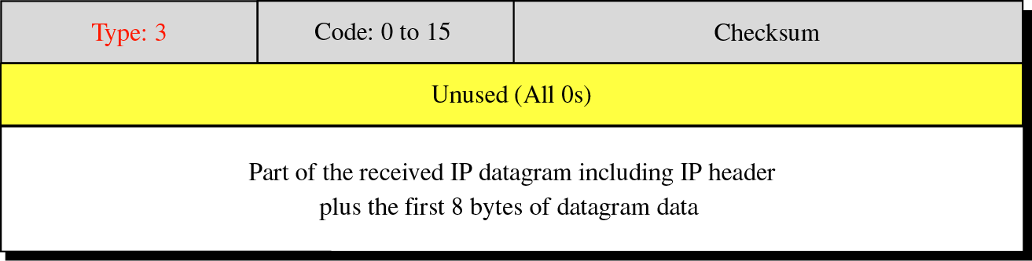
Destination-unreachable format

Slide 48
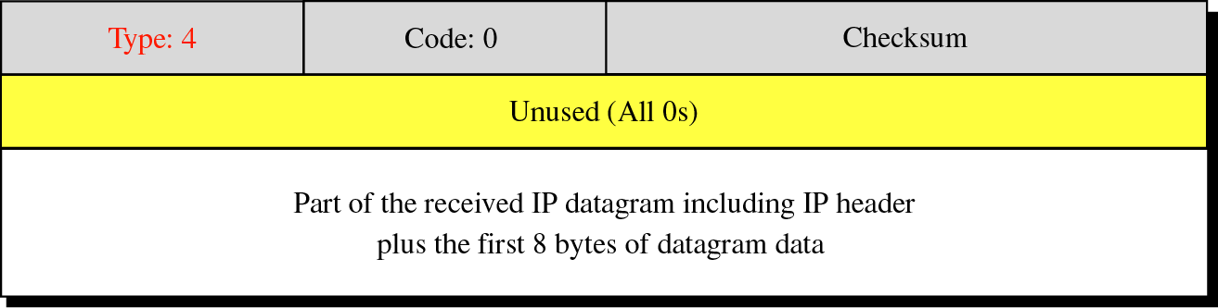
Source-quench format

Slide 49
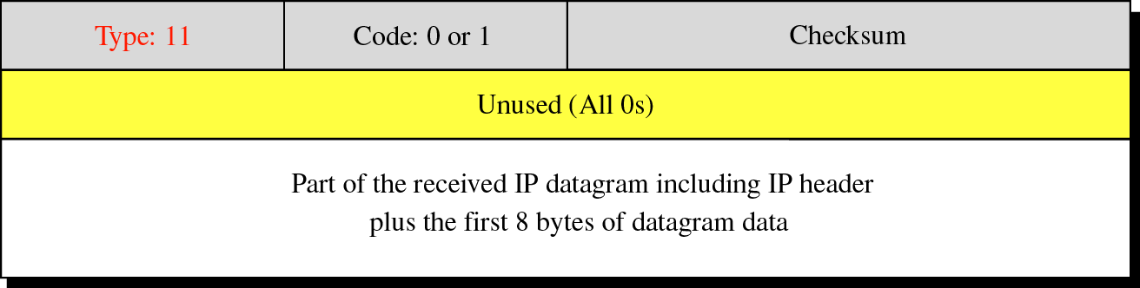
Time-exceeded message format
Code 0: Time to live Code 1: Fragmentation

Slide 50
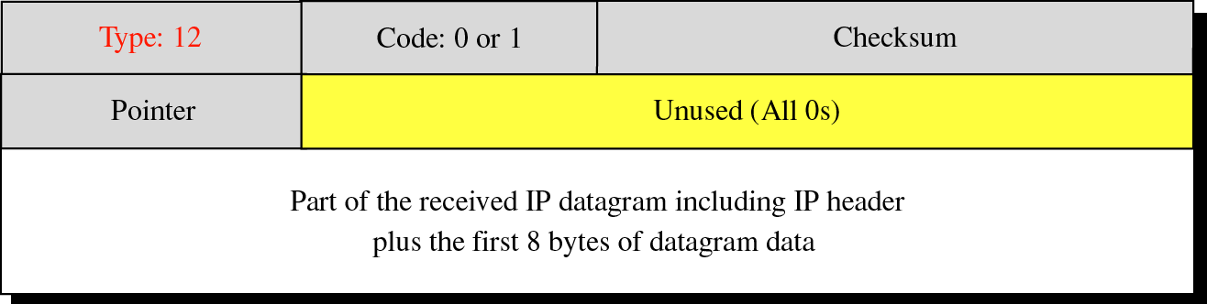
Parameter-problem message format
Code 0: Main header problem Code 1: Problem in the option field

Slide 51
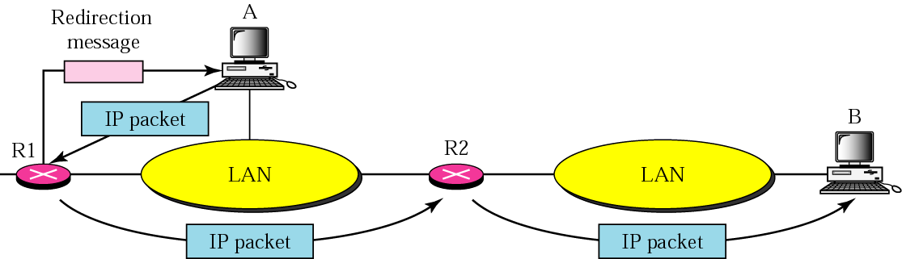
Redirection concept

Slide 52
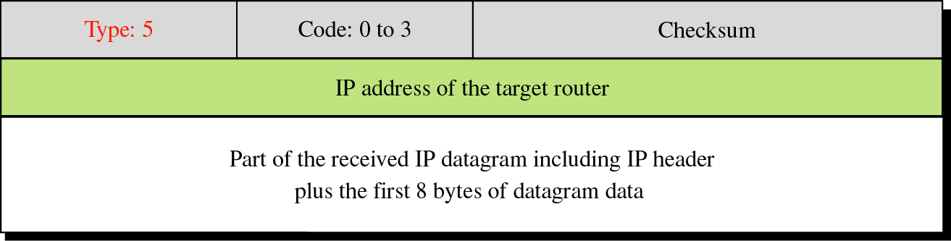
Redirection message format
Code 0: Network specific Code 1: Host specific Code 2: Network specific (specified service)
Code 3: Host specific (specified service)

Slide 53
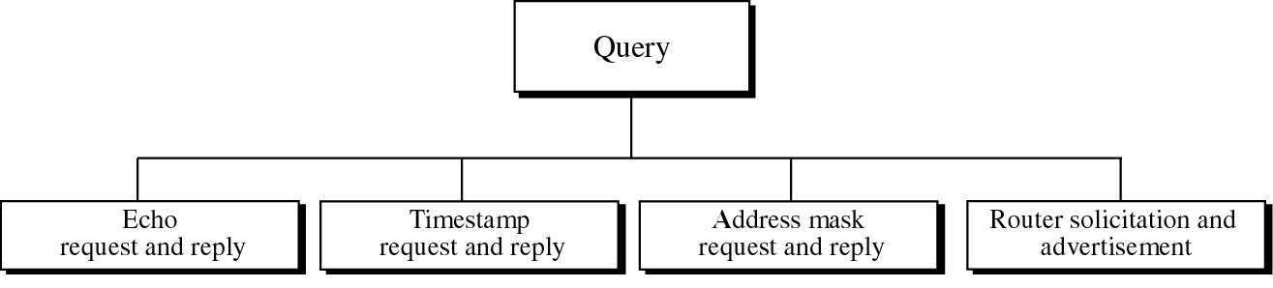
Query messages

Slide 54
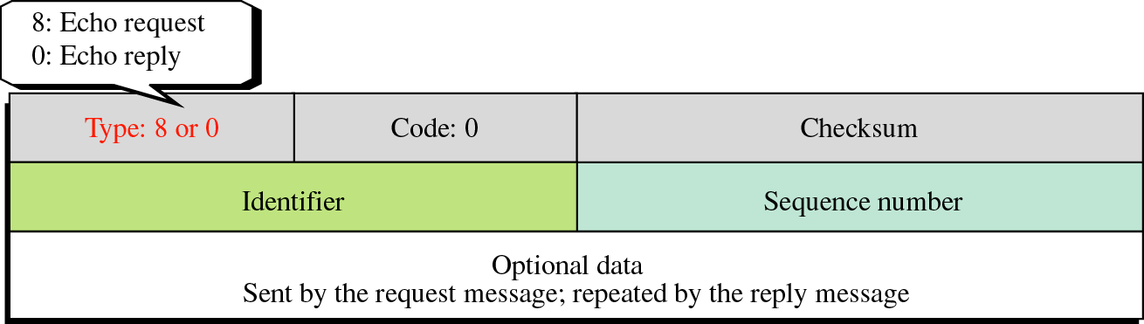
Echo-request and echo-reply message format
Ping command can use
theses messages.

Slide 55
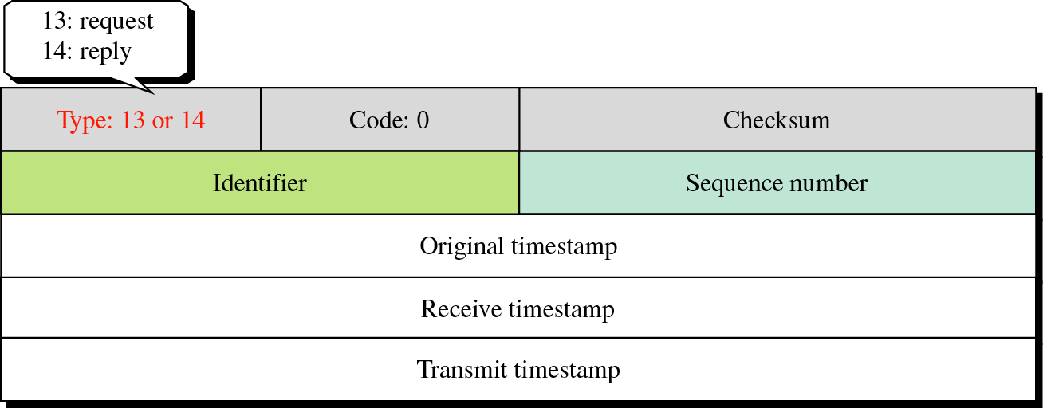
Timestamp-request and
timestamp-reply message format

Slide 56
Sending time = value of receive timestamp −
value of original timestamp
Receiving time = time the packet returned −
value of transmit timestamp
Round-trip time = sending time +
receiving time

Slide 57
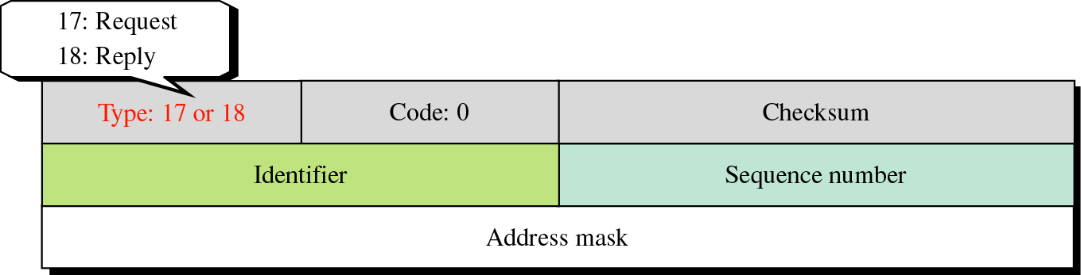
Mask-request and mask-reply
message format

Slide 58
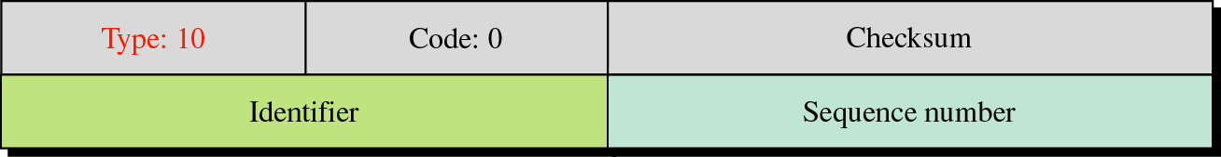
Router solicitation message format

Slide 59
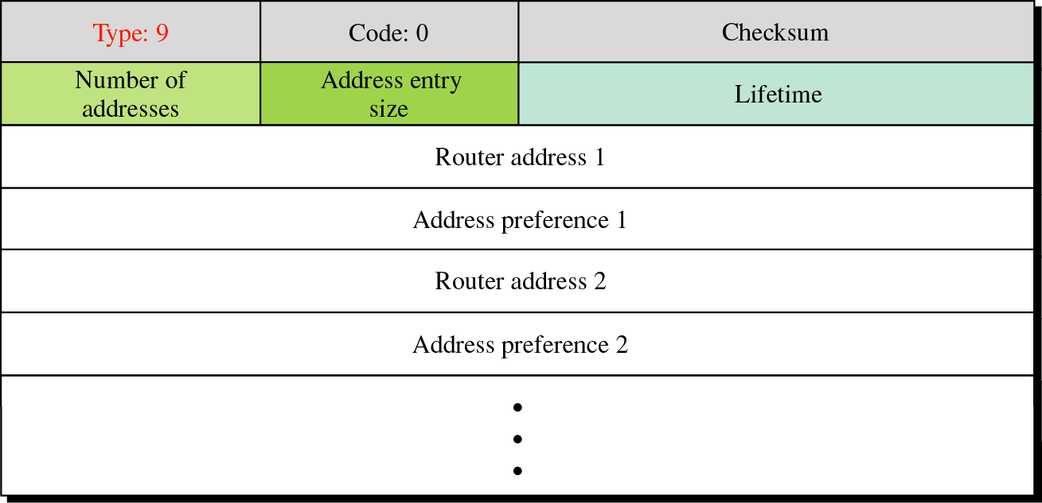
Router advertisement message format

